Slide 1

Petroleum Vapor Intrusion (PVI)
Updates to the DEQ Vapor Intrusion Guide
By: Latysha Pankratz

Slide 2
Outline
Important Changes to DEQ’s VI Guide:
  A PVI-specific section was added.
Adopting the 3-step approach to assessing the PVI Pathway (EPA & ITRC).
Apply a phased sampling approach when the release does not screen out.

Slide 3
Important Changes to DEQ’s VI Guide
Petroleum Specific Section
Lateral screening distance is reduced from 100 feet to 30 feet.
Vertical screening distances are introduced.
An attenuation factor has been adopted from EPA to be applied at PVI sites.
Phased sampling approach to assess PVI pathway completion

Slide 4
3-Step Approach to Assessing the PVI Pathway
Does the Release Screen Out?

Slide 5
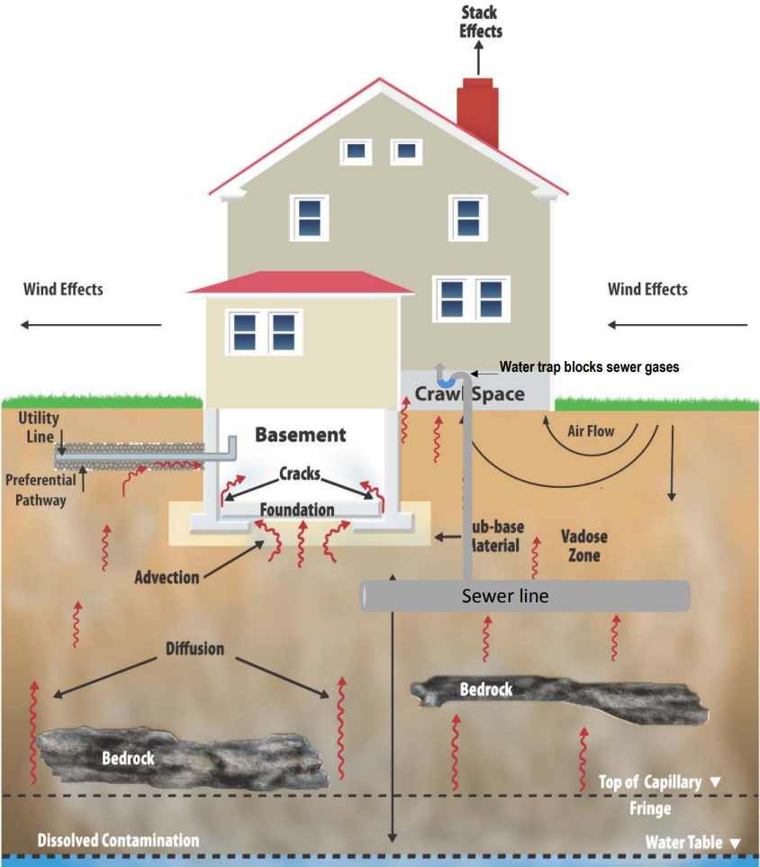
Step 1:
Development of CSM
When completing the CSM several questions should be asked to identify any precluding factors and/or preferential pathways that would eliminate site from using lateral and vertical screening distances.

Slide 6

These Questions Include (but are not limited to):
Are lead scavengers 1,2 DCA or EDB present?
Is methane present?
Was the fuel greater than 10 % ethanol?
Is the basement floor made of dirt or have cracked foundation?
Is there a sump present?
Do utility corridors intersect contaminated soil or groundwater?
Is any part of the building in direct contact with petroleum contamination?
Do preferential pathways exist?
Is the plume expanding or advancing or is there a continued source of release?
Is there peat soils or excessively dry soils (<2% oxygen present)?
IF YOU ANSWER YES TO ANY OF THE ABOVE QUESTIONS YOU CANNOT APPLY SCREENING DISTANCES TO RULE OUT THE PVI PATHWAY!!!

Slide 7
Step 2:
Lateral Inclusion Zone
After completion of the CSM;
And, in the absence of any precluding factors and preferential pathways;
Determine if any buildings are within 30 lateral feet of contaminated soil and/or groundwater.
If no buildings within 30 lateral feet, the PVI pathway can be determined incomplete and no further PVI analysis is necessary.

Slide 8
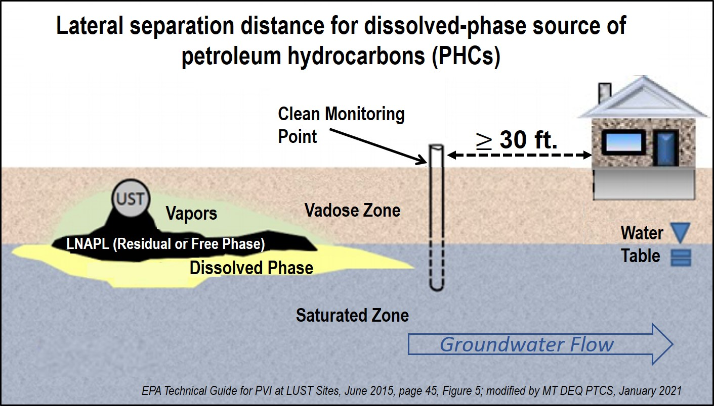

Slide 9
Step 3:
Vertical Screening Distance
If the release does not screen out based on lateral screening distance (contamination is WITHIN 30 lateral feet of a structure), a vertical screening distance can be applied.
For LNAPL contamination the vertical screening distance is 15 feet from the lowest point on the building to the highest point of contamination.
For dissolved phase contamination the vertical screening distance is 8 feet from the lowest point on the building to the highest point of contamination.
(DEQ is determining acceptable and conservative levels of Benzene and TPH in soil and groundwater that would determine which screening distance should be applied, i.e. if Benzene exceeds 5000 ug/L in groundwater the 15-foot screening distance would need to be applied)

Slide 10
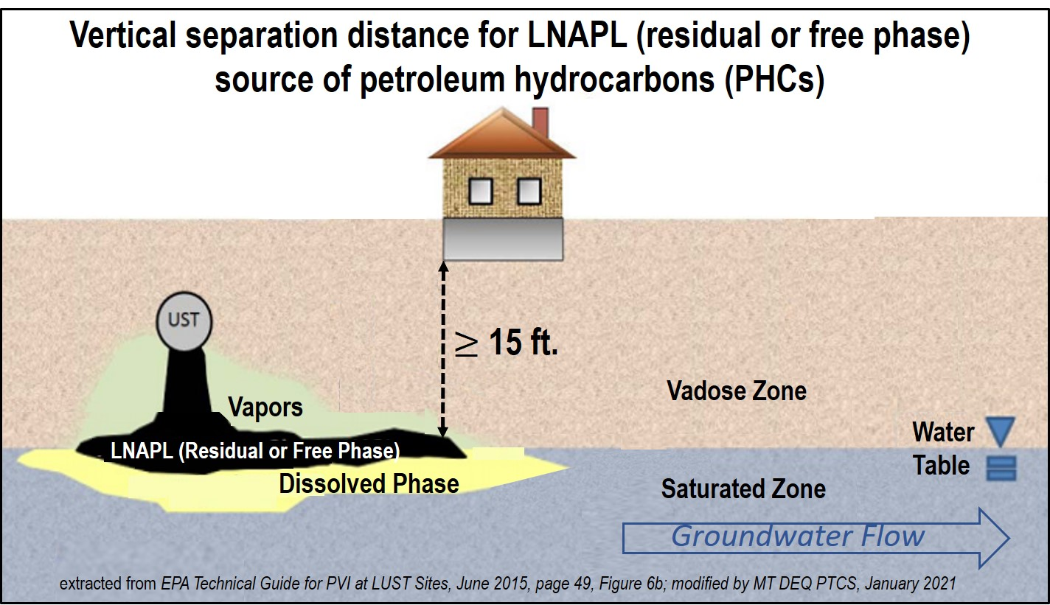

Slide 11
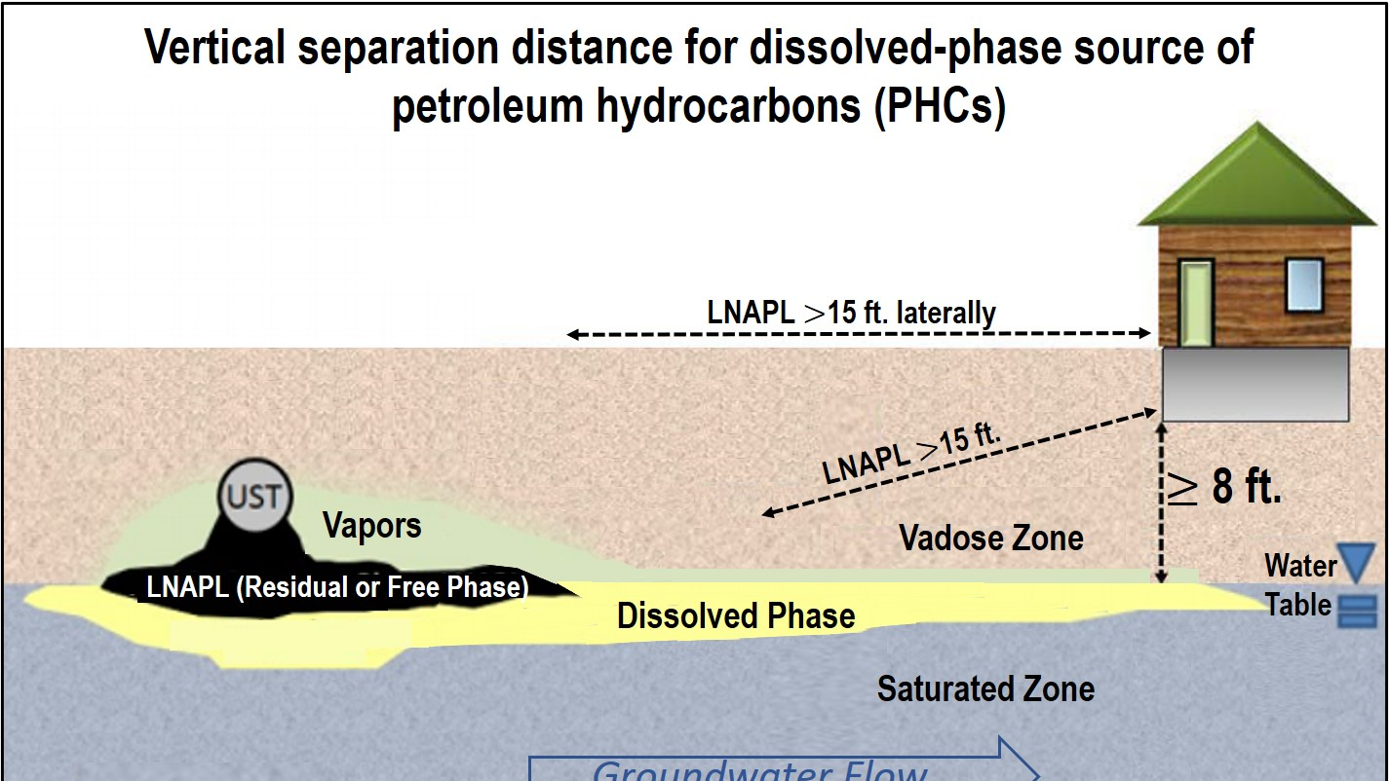

Slide 12
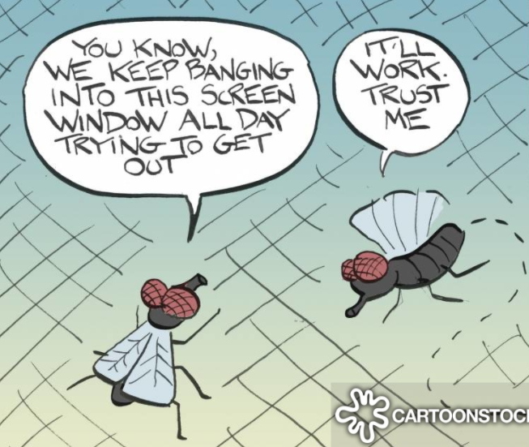
What Next?
When the PVI pathway does not screen out…
Mitigation?!
Sampling – Phased Approach.

Slide 13
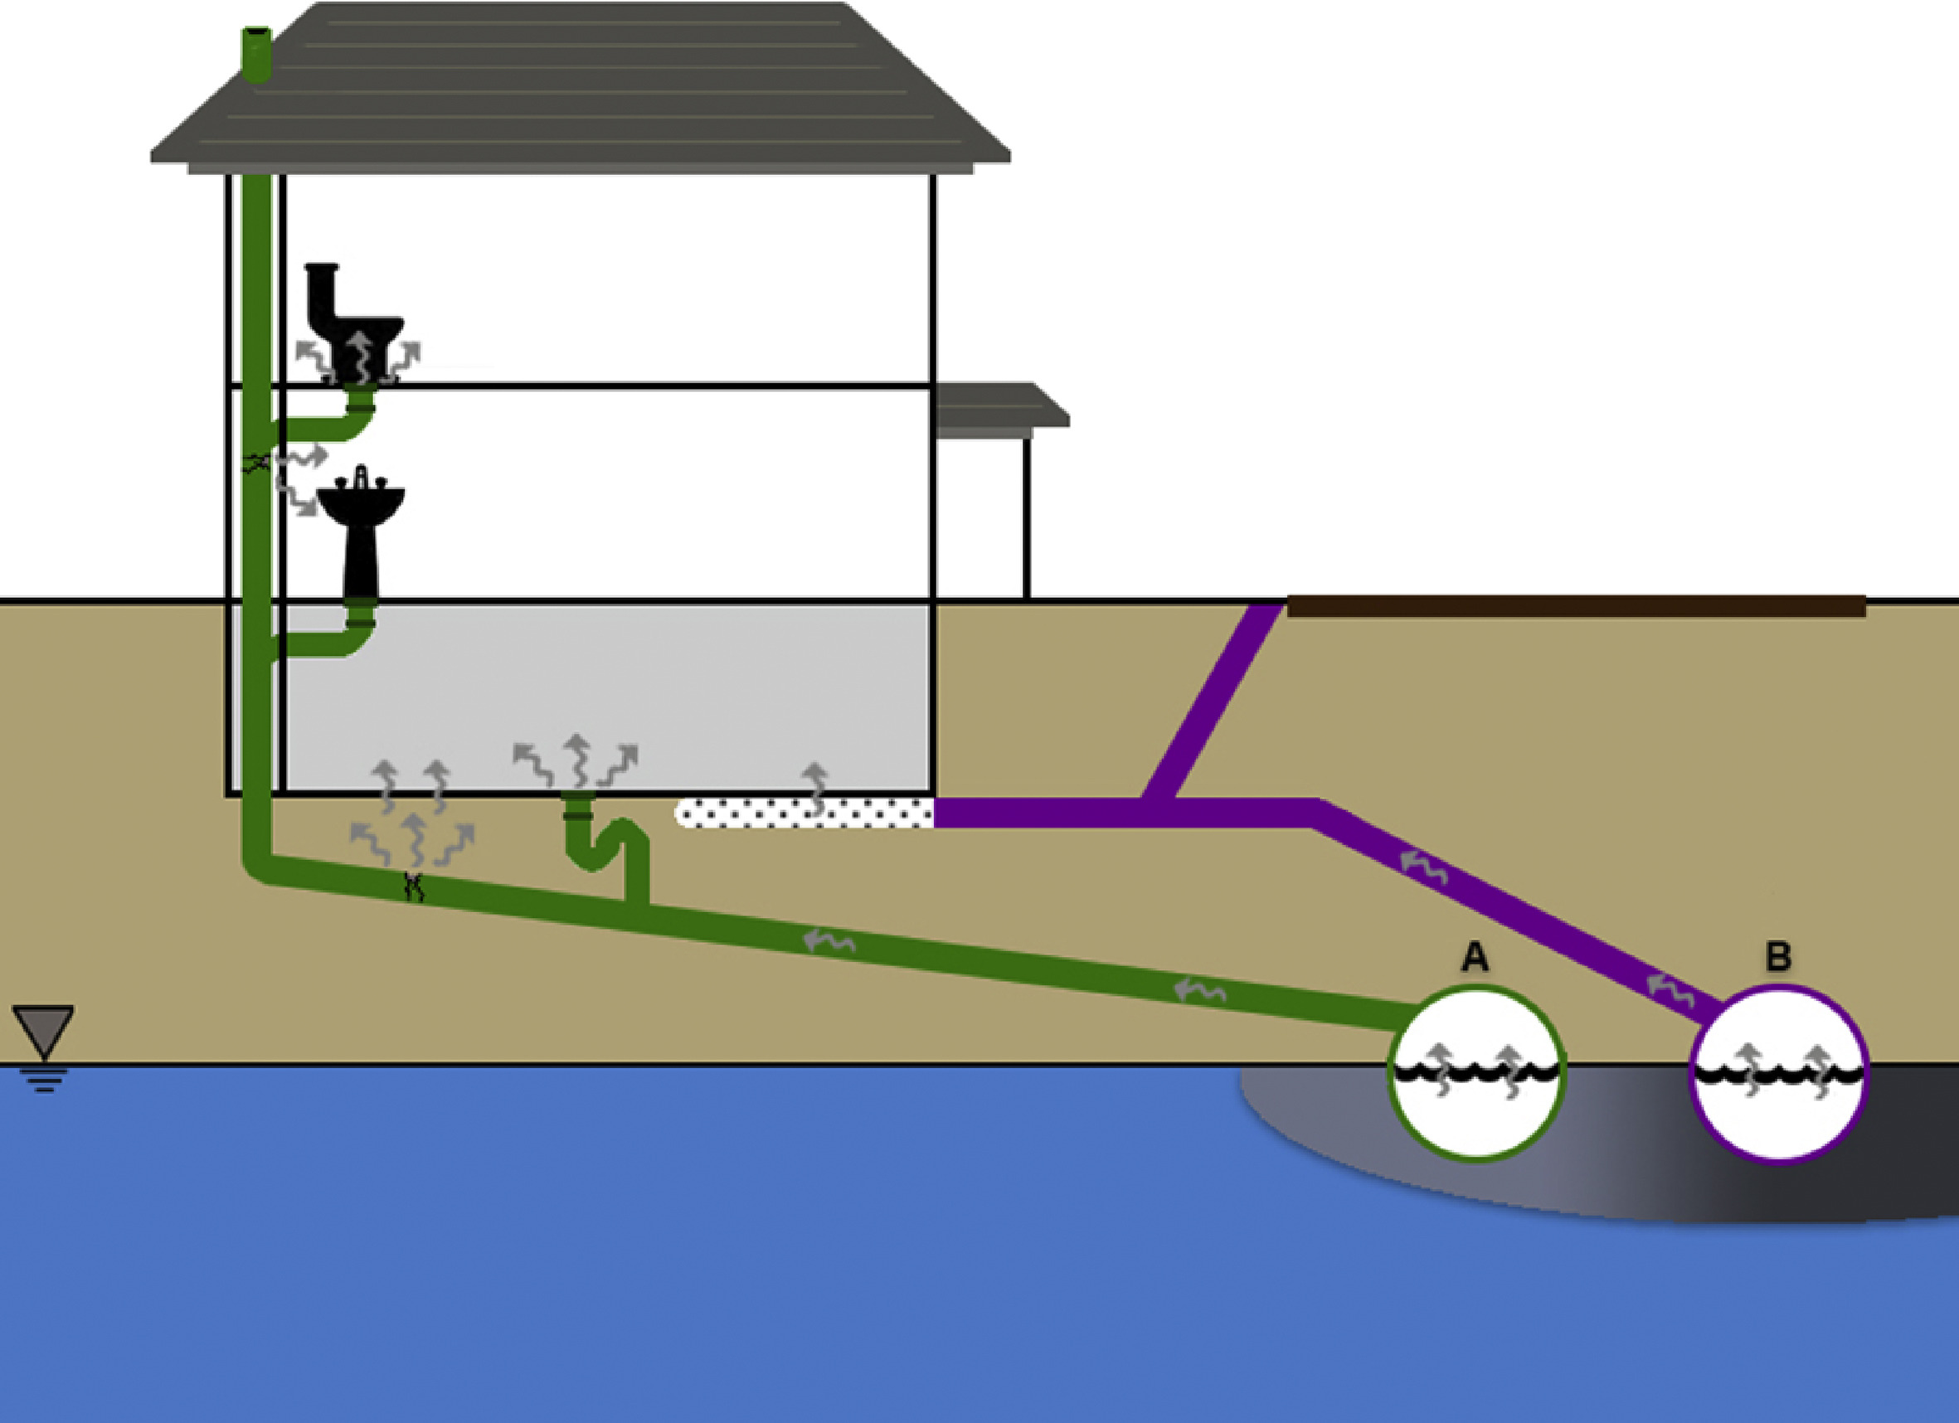
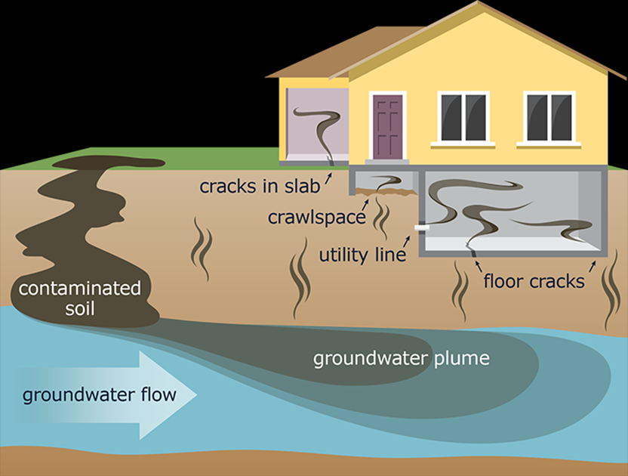
Scenario #1
A preferential pathway has been identified!
May require going straight to vapor mitigation and indoor air sampling.
Notes:
Simplified Conceptual Model for Sewer Preferential Pathway Vapor Intrusion: A) Sanitary sewer line, B) Storm sewer or land drain system connected to building foundation drain (not applicable for some buildings). In some older sewer systems, sanitary and storm water flow through a combined sewer system.

Slide 14
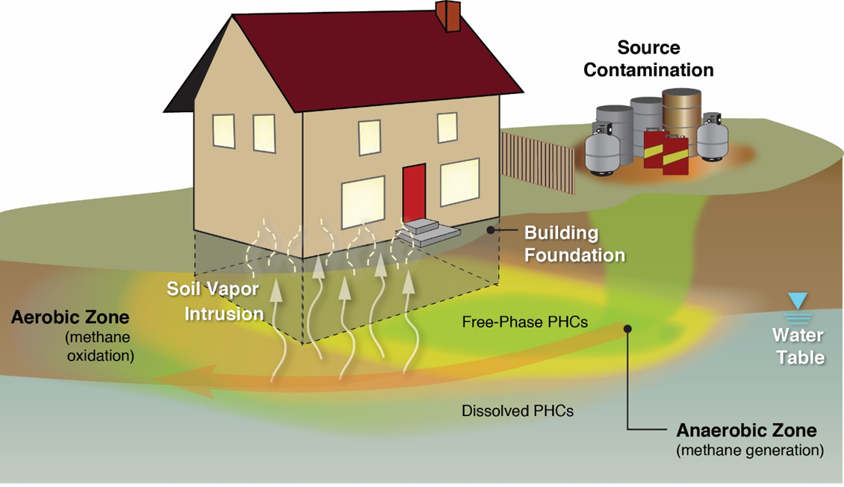
Scenario #2
A precluding factor has been identified!
Example – the basement foundation is in direct contact with petroleum contaminated soil and/or groundwater.
Sampling will likely require indoor air along with ambient air (could include crawlspace and in some cases sub-slab).

Slide 15
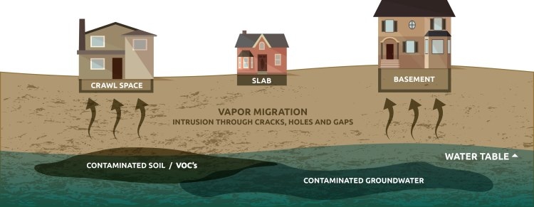
Scenario #3
Building determined to not screen out laterally and vertically (but no preferential pathway or precluding factors exist);
Phased-Approach
Start with soil vapor sampling which may include nested probes;
If soil vapor sampling cannot rule out the PVI pathway move onto sub-slab sampling and apply the attenuation factor (adopted from EPA);
When sub-slab sampling cannot rule out PVI pathway completion move onto sampling the crawlspace/basement and indoor air and ambient air.
More than one sampling event may be required to assess PVI threat.

Slide 16

Site-Specific Scenarios
Although we anticipate that the upcoming changes to the VI Guidance will apply to most PVI Scenarios there may be situations that will warrant reference to the EPA and/or ITRC’s more in-depth guidances and as always discuss with the DEQ Project Officer.

Slide 17
Questions ?

